Slide 1
Final DEMO
Kingsmen
Samuel Akinfenwa, Brent Hedden, Alain Kagaba, Smit Patel, Jonathan Selvage

Slide 2
Agenda
Product description
Demo
Questions

Slide 3
Intro
Today we will be going over our final updates for our website for the Student Recreation Center.
We will give an overview of how the process to make those updates.
We will cover most of the high priority functionality as well include some of the low priority.
At the end we will ask for any of your questions.

Slide 4
Technology
Microsoft Visual Studio 2019 for ASP.NET C#.
Various 3rd party bootstrap queries, libraries, and plugins
Microsoft SQL Server 2019 for our locally based database

Slide 5
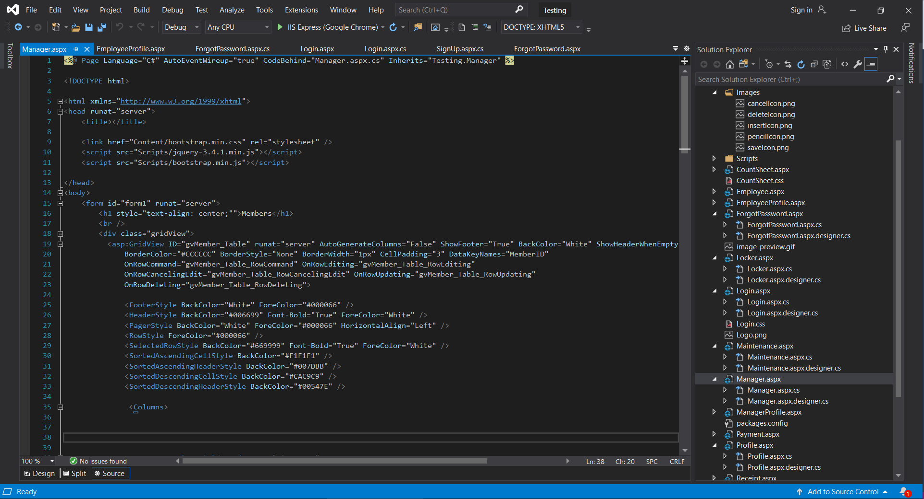
Screenshots of our code and database

Slide 6
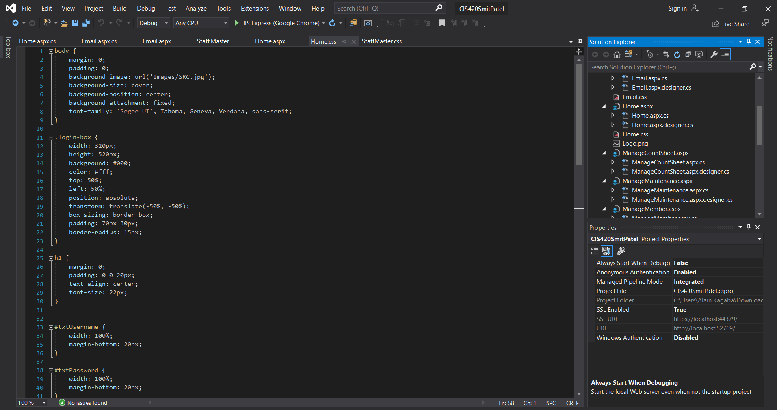

Slide 7
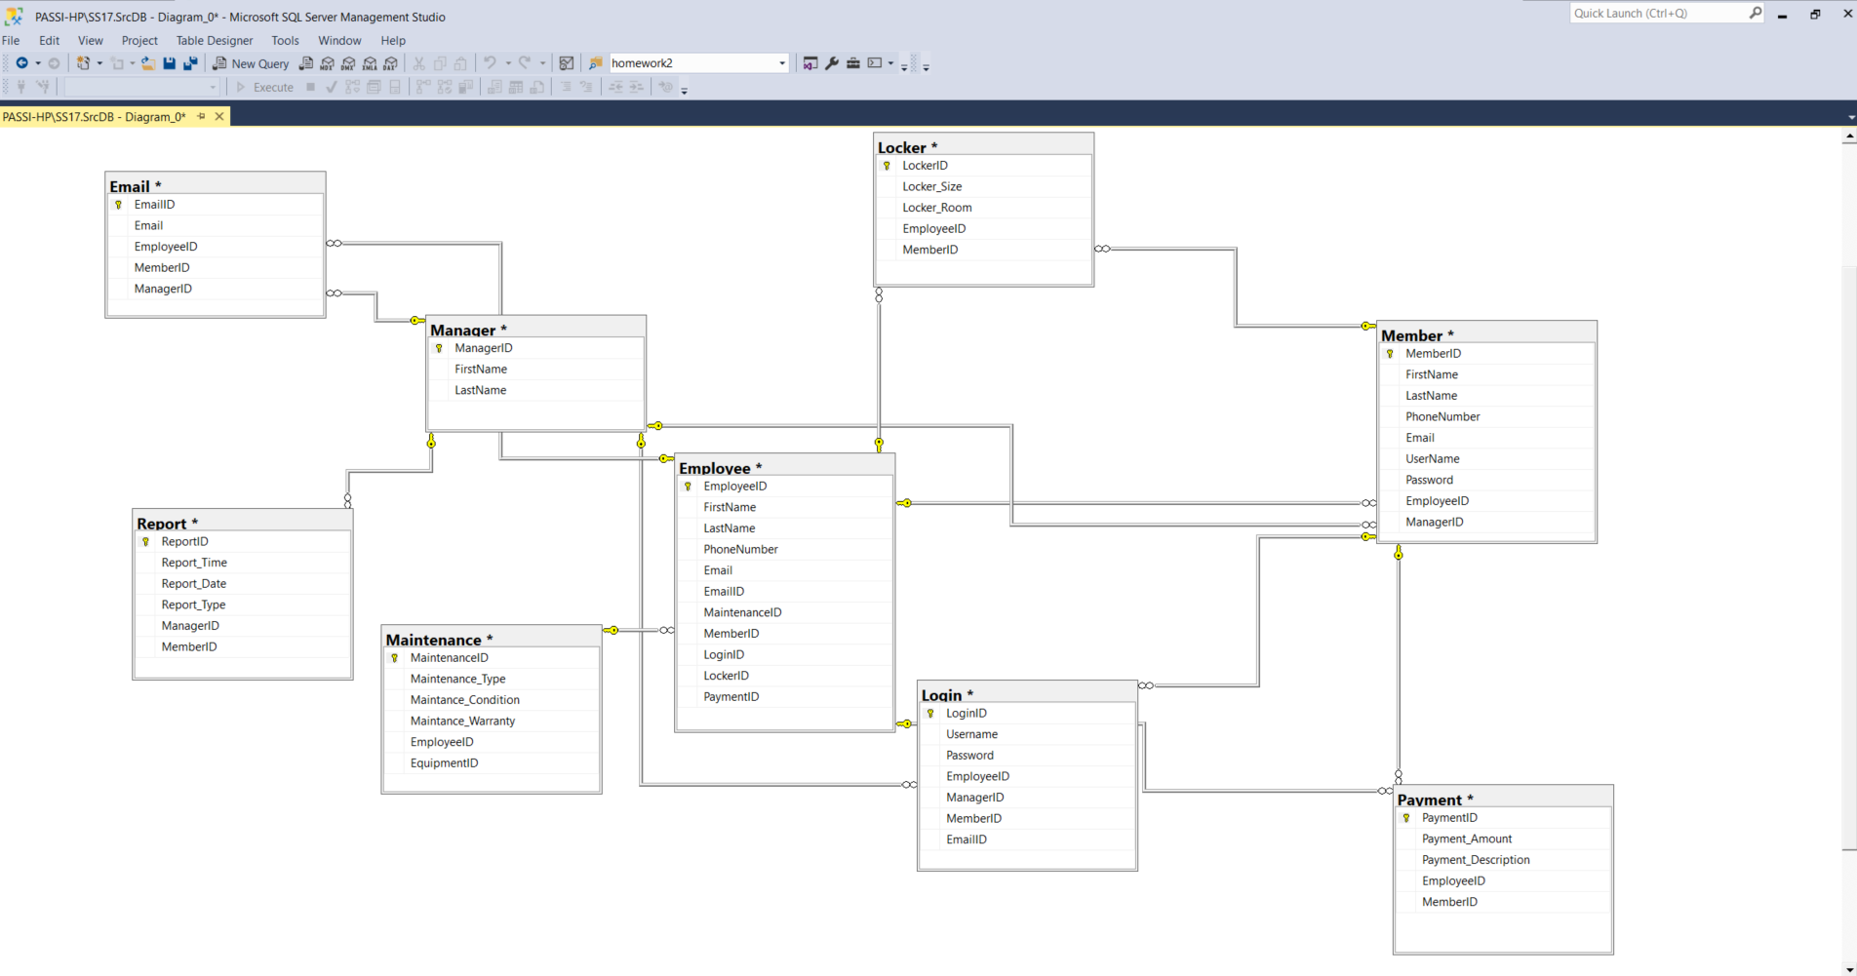
Database

Slide 8
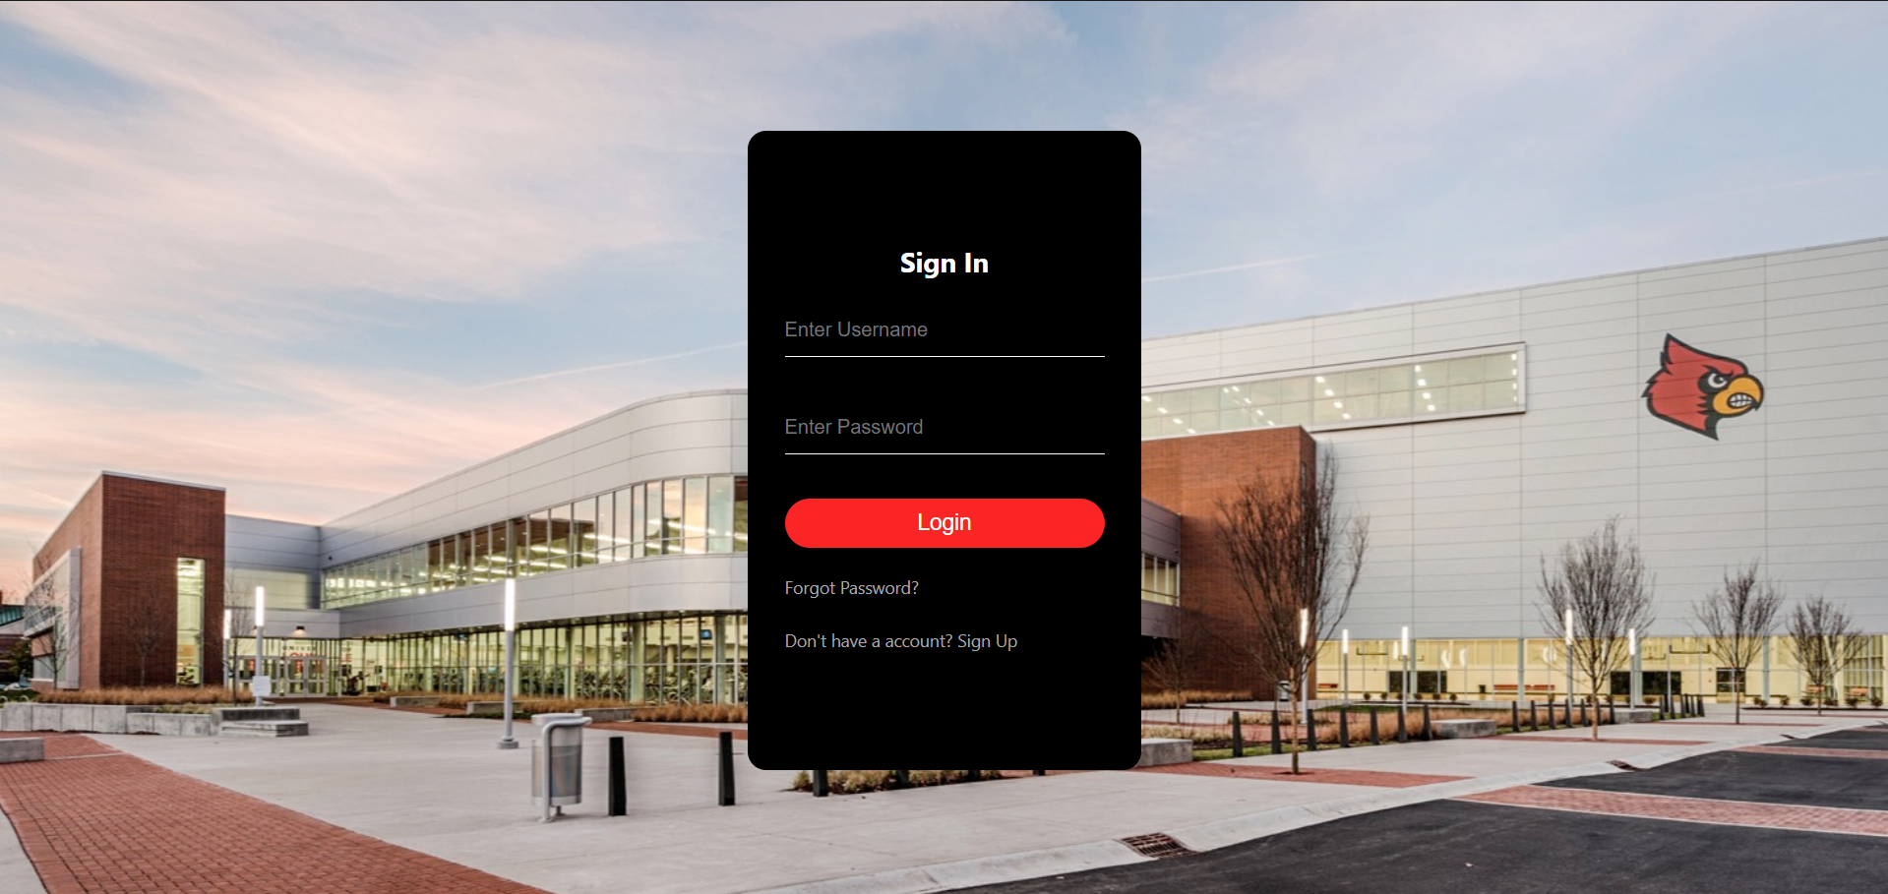
Let’s go on with the DEMO!

